Slide 1
Consulting Proposal
MetricMonkey
Vidhi, Abhijay, Aashish, Vignesh

Slide 2
Overview
VGAMERZ: A game development company.
We understood from our client that they’ve been in the game development business for a while, developing various kinds of games. Our client provided us with a dataset for the same containing the details of over 16000+ games and asked us to analyze their performance and answer 2 simple question:
Which is their BEST performing PLATFORM?
Which is their BEST performing GENRE?

Slide 3

Best Platform
Sales
Revenue
Critic Scores
Console Price
Notes:
Only considered past 5 years for a better understanding of the changing market, however all these platforms have performed considerably well over the course of the decades, be it Nintendo, Sony, Microsoft.

Slide 4

Best Genre
Sales
Revenue
Critic Scores
Role-Playing
safe-bet & performs on select (Nintendo) console!

Slide 5
Why Nintendo Market?
Market Segmentation
Offers plethora of different products
Broad target market
Strong Distribution Channels
Powerful, Product availability
Physical - gaming stores, hypermarkets, electrical retail outlets
Online - amazon, eBay
Competitive Advantage
Brand Name - legacy brand; donkey kong, pokemon, zelda
Pricing Strategy - affordable, made for all
Strong console market - Sales, Revenue, Score

Slide 6

However..
In the coming age and advent of internet and faster network services the GENRE SHOOTER stood out the most with great sales, revenue and critic scores.
The Call Of Duty Series are the most successful and we recommend the client to continue these series with more additions as these have a great scope!

Slide 7
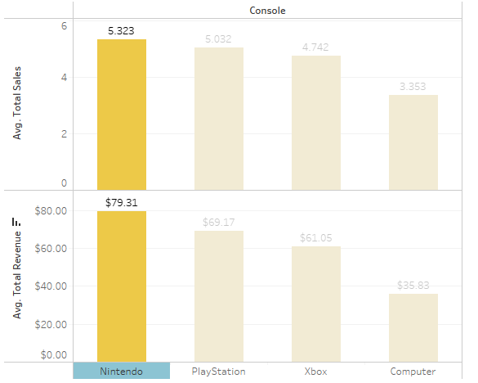
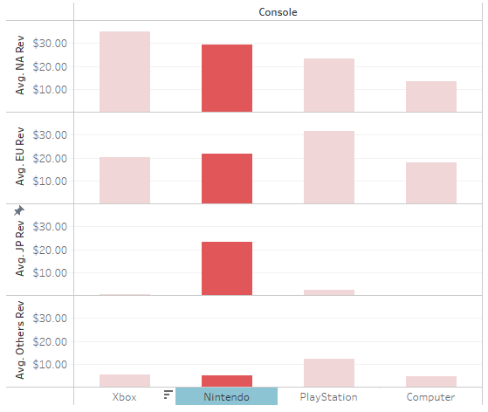
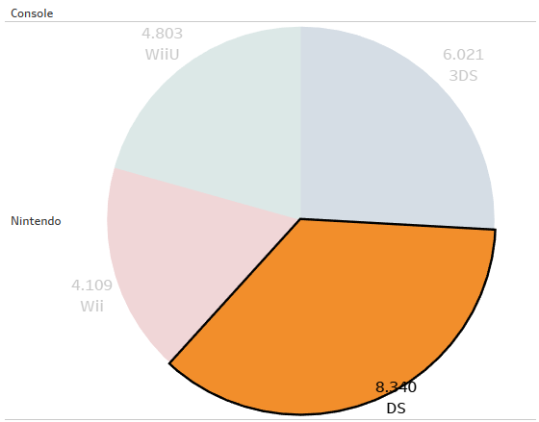
Appendix
Sales & Revenue
Stable across region
Sub-Platform

Slide 8
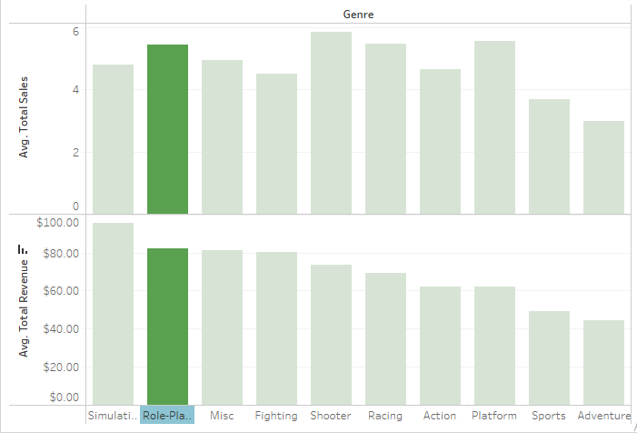
Role-Playing

Slide 9
Additional Info:
16598 data values re-ranked using dense_rank.
Narrowed down to 702 records using top 500 rank
Summation of all sales into total sales
Added prices
Added critic scores
Calculated revenue
Considered years from 2011-2015 to notice latest choices and preferences
Consolidated platforms into consoles
Derived a console based genre in order to help sales and cut costs.

